Slide 1
Loops in programming come into use when we need to repeatedly execute a block of statements.
Example:
Suppose we want to print “Hello World” 10 times. This can be done in two ways as shown below:
Iterative Method
An iterative method to do this is to write the printf() statement 10 times.
Loops in C

Slide 2
In Loop, the statement needs to be written only once and the loop will be executed 10 times as shown below.
In computer programming, a loop is a sequence of instructions that is repeated until a certain condition is reached.
An operation is done, such as getting an item of data and changing it, and then some condition is checked such as whether a counter has reached a prescribed number.
Using Loops

Slide 3
Counter not Reached :
If the counter has not reached the desired number, the next instruction in the sequence returns to the first instruction in the sequence and repeat it.
Counter reached :
If the condition has been reached, the next instruction “falls through” to the next sequential instruction or branches outside the loop..
Using Loops

Slide 4
Entry Controlled loops :
In this type of loops the test condition is tested before entering the loop body. For Loop and While Loop are entry controlled loops.
Exit Controlled Loops:
In this type of loops the test condition is tested or evaluated at the end of loop body. Therefore, the loop body will execute atleast once, irrespective of whether the test condition is true or false. do – while loop is exit controlled loop.
Types of Loops

Slide 5
Syntax :
while (test_expression)
{
// statements
update_expression;
}
The various parts of the While loop are :
Test Expression :
In this expression we have to test the condition. If the condition evaluates to true then we will execute the body of the loop and go to update expression.
Otherwise, we will exit from the while loop.
While loop in C

Slide 6
while
do ... while
for
while :
The while loop in C is used in situations where we do not know the exact number of iterations of loop beforehand. The loop execution is terminated on the basis of the test condition.
Suppose, we want to print "He is the best" 10 times. One way to get the desired output. We write 10 printf statements, which is not preferable.
Other way out is - use loop.
Iterative loop statements in C

Slide 7
While loop example
#include<stdio.h>
int main()
{
int i=0;
while(i<10)
{
printf("Hello world\n");
i++;
}
}

Slide 8
While loop example
#include<stdio.h>
int main()
{
int i=0;
/*
while(i++ < 5)
printf("i = %d\n",i);
*/
while(i++ < 5);
printf("i = %d\n",i);
}

Slide 9
While loop example
#include<stdio.h>
int main()
{
int i=0;
/*
while(++i < 5)
printf("i = %d\n",i);
*/
while(++i < 5);
printf("i = %d\n",i);
}

Slide 10
While loop example
#include<stdio.h>
int main()
{
int i=1,n;
printf("Enter the n value\n");
scanf("%d",&n);
while(i<=n)
{
printf("%d ",i);
i++;
}
printf("\n");
}

Slide 11
no.of digits in a given number
#include<stdio.h>
int main()
{
int count = 0,n;
printf("Enter the n value\n");
scanf("%d",&n);
/* while(n != 0)
{
n /= 10;
count++;
} */
while(n /= 10, count++, n != 0);
printf("no.of digits : %d\n",count);
}

Slide 12
no.of even digits of a given number
#include<stdio.h>
int main()
{
int even = 0,n,r;
printf("Enter the n value\n");
scanf("%d",&n);
/*
while(n != 0)
{
r = n%10;
if(r%2 == 0)
even++;
n /= 10;
}
*/
// while(r = n%10,(r%2==0)?even++:0,n /= 10, n != 0);

Slide 13
Sum of digits of a given number
#include<stdio.h>
int main()
{
int n,r,s=0;
printf("Enter the n value\n");
scanf("%d",&n);
/*
while(n != 0)
{
r = n%10;
s += r;
n /= 10;
}
*/

Slide 14
Sum of digits of a given number
/*
while(n != 0)
{
s += (n%10);
n /= 10;
}
*/
while(s += (n%10), n /= 10, n != 0);
printf("sum of digits : %d\n",s);
}

Slide 15
Reversing the number
#include<stdio.h>
int main()
{
int num,rem,rev=0;
printf("Enter the number\n");
scanf("%d",&num);
/*
while(num != 0)
{
rem = num%10;
rev = rev*10+rem;
num = num/10;
}
*/

Slide 16
Reversing the number
/*
while(num != 0)
{
rev = rev*10+(num%10);
num /= 10;
}
*/
while(rev = rev*10+(num%10),num /= 10,num != 0);
printf("reversing number : %d\n",rev);
}

Slide 17
Palindrome number or not.
#include<stdio.h>
int main()
{
int temp,num,rev=0;
printf("Enter the number\n");
scanf("%d",&num);
temp = num;
while(rev = rev*10+(temp%10),temp /= 10,temp != 0);
if(num == rev)
printf("Palindrome number\n");
else
printf("Not Palindrome number\n");
}

Slide 18
Factorial of a given number
#include<stdio.h>
int main()
{
int n,temp,f=1;
printf("Enter the n value\n");
scanf("%d",&n);
temp = n;
if(n < 0) {
printf("Invalid number for factorial\n");
return 0;
}

Slide 19
Factorial of a given number
/*
while(n != 0)
{
f *= n;
n--;
}
*/
while((n!=0)&&(f *= n,n--));
printf("%d! = %d\n",temp,f);
}

Slide 20
Fibonacci series upto given n value
#include<stdio.h>
int main()
{
int a=0,b=1,c,n;
printf("Enter the n value\n");
scanf("%d",&n);
/*
while(a<=n)
{
printf("%d ",a);
c = a+b;
a = b;
b = c;
}
*/
while((a<=n)&&(printf("%d ",a),c=a+b,a=b,b=c));
printf("\n");
}

Slide 21
initialization expression;
do
{
// statements
update_expression;
} while (test_expression);
Note: Notice the semi – colon(“;”) in the end of loop.
Description :
In do while loops also the loop execution is terminated on the basis of test condition. The main difference between do while loop and while loop is in do while loop the condition is tested. At the end of loop body, i.e do while loop is exit controlled whereas the other two loops are entry controlled loops.
Note:
In do while loop the loop body will execute at least once irrespective of test condition.
do .. while loop in C

Slide 22
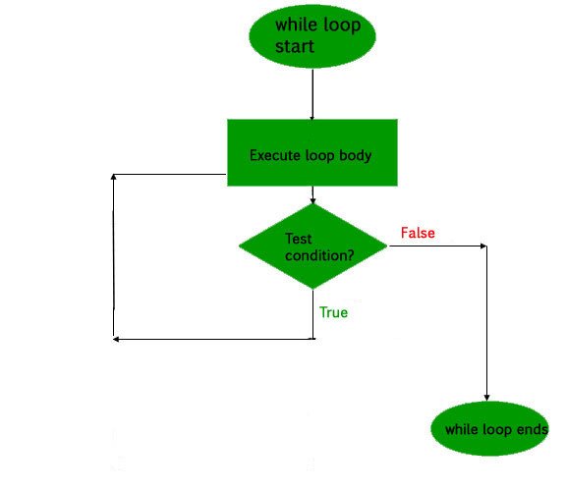
do while loop in C

Slide 23
Example :
do while loop in C
int main()
{
int i = 2; // Initialization expression
do
{
// loop body
printf( "Hello World\n");
// update expression
i++;
} while (i < 1); // test expression
}
Output
Hello World

Slide 24
do-while example
#include<stdio.h>
int main()
{
char ch;
do {
printf("Hello...\n");
printf("Do u want to print Hello again(y/n)\n");
scanf(" %c",&ch);
}
while((ch == 'y')||(ch == 'Y'));
}

Slide 25
do-while example
#include<stdio.h>
int main()
{
int i = 0;
do
printf("Hello...\n");
while(i++<5);
printf("i = %d\n",i);
}

Slide 26
do-while example
#include<stdio.h>
int main()
{
int i = 0;
do {
printf("Hello...\n");
printf("Hai...\n");
}
while(++i<5);
}

Slide 27
do-while example
#include<stdio.h>
int main()
{
char ch = 'A';
int i = 0;
do
putchar(ch);
while((++i<=5)||(ch++<='F'));
printf("\ni - %d\n",i);
}

Slide 28
do-while example
#include<stdio.h>
int main()
{
char ch,op;
do {
printf("Enter the char\n");
scanf(" %c",&ch);
if((ch>='A')&&(ch<='Z') printf("Upper case char\n");
else if((ch>='a')&&(ch<='z')) printf("Lower case char\n");
else if((ch>='0')&&(ch<='9')) printf("Digit\n");
else printf("Special char\n");
printf("Do u want to continue(y/n)\n");
scanf(" %c",&op);
}while((op == 'y')||(op == 'Y'));
}

Slide 29
Syntax :
for (initialization expr; test expr; update expr)
{
// body of the loop
// statements we want to execute
}
Description :
A for loop is a repetition control structure which allows us to write a loop that is executed a specific number of times. The loop enables us to perform n number of steps together in one line.
In for loop, a loop variable is used to control the loop. First initialize this loop variable to some value, then check whether this variable is less than or greater than counter value. If statement is true, then loop body is executed and loop variable gets updated . Steps are repeated till exit condition comes.
for loop in C

Slide 30
Initialization Expression :
In this expression we have to initialize the loop counter to some value.
Example :
int i=1;
Test Expression :
In this expression we have to test the condition. If the condition evaluates to true then we will execute the body of loop and go to update expression otherwise we will exit from the for loop.
Example :
i <= 10;
Update Expression:
After executing loop body this expression increments/decrements the loop variable by some value. for example: i++;
for loop in C

Slide 31
for loop in C

Slide 32
Example :
for loop in C
int main()
{
int i=0;
for (i = 1; i <= 5; i++)
{
printf( "Hello World\n");
}
return 0;
}
Output
Hello World
Hello World
Hello World
Hello World
Hello World

Slide 33
An infinite loop (sometimes called an endless loop ) is a piece of coding that lacks a functional exit so that it repeats indefinitely. An infinite loop occurs when a condition always evaluates to true. Usually, this is an error.
Example :
int main ()
{
int i;
for ( ; ; )
{
printf("This loop will run forever.\n");
}
Output:
This loop will run forever.
This loop will run forever.
…..........
…..........
Infinite loop in C

Slide 34
Syntax :
break;
Description :
This loop control statement is used to terminate the loop. As soon as the break statement is encountered from within a loop, the loop iterations stops there and control returns from the loop immediately to the first statement after the loop.
Basically break statements are used in the situations when we are not sure about the actual number of iterations for the loop or we want to terminate the loop based on some condition.
break statement in C

Slide 35
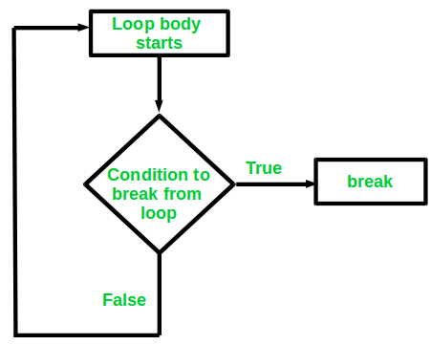
Flow chart :
break statement in C

Slide 36
Example :
break statement in C
int main()
{
Int i ;
for (i = 1; i < 3; i++)
{
printf( "Test1\n");
printf( "i=%d\n",i);
break;
}
printf( "i=%d\n",i);
}
Output
Test1
1
Test1
2
3

Slide 37
Explanation : Once in a loop break is executed then the condition will come out of loop.
Example :
break statement in C
int main()
{
Int I = 2 ;
if ( i < 5 )
break ;
else
printf( "Hello\n");
printf( "i=%d\n",i);
}
Output
Compile time error
Note : break should be used only in loops and switch
case

Slide 38
Syntax :
return;
Return
Control return Value return
( control with value return )
return statement in C

Slide 39
The return in C returns the flow of the execution to the function from where it is called.
This statement does not mandatory need any conditional statements. As soon as the statement is executed, the flow of the program stops immediately and return the control from where it was called.
The return statement may or may not return anything for a void function, but for a non-void function, a return value is must be returned
Return is used in functions, In a function once return is executed, control is back to whoever called that function.
Main also one function called by _start function.
Return is exclusively used for functions.
return statement in C

Slide 40
Example :
return statement in C
int main()
{
printf( "Hi\n");
return;
printf( "Hello\n");
}
Output
Hi

Slide 41
Continue is exclusively used in loops.
In a program, If we use continue, the loop is continued till the condition is false.
This loop control statement is just like the break statement. The continue statement is opposite to that of break statement, instead of terminating the loop, it forces to execute the next iteration of the loop.
As the name suggest the continue statement forces the loop to continue or execute the next iteration. When the continue statement is executed in the loop, the code inside the loop following the continue statement will be skipped and next iteration of the loop will begin.
continue statement in C

Slide 42
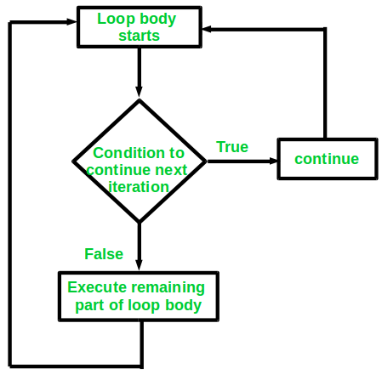
Flow chart :
continue statement in C

Slide 43
Example :
continue statement in C
int main()
{
for (i = 1; i < 3; i++)
{
printf( "Hello\n");
continue
Printf(“Hi\n”);
}
printf( "After loop\n”);
}
Output
Hello
Hello
Hello
After loop

Slide 44
for loop
#include<stdio.h>
int main()
{
int i;
for(i=0;i<5;i++)
{
printf("Hello...\n");
printf("i = %d\n",i);
}
}

Slide 45
For loop examples
#include<stdio.h>
int main()
{
int i;
for(i=0;i<5;i++);
{
printf("Hello...\n");
printf("i = %d\n",i);
}
}

Slide 46
for loop example
/*
for(i=0;i<5;i++)
{
; //dummy statement
}
{
printf("Hello...\n");
printf("i = %d\n",i);
}
*/

Slide 47
Infinite for loop
#include<stdio.h>
int main()
{
for(;;)
printf("Hello...\n");
}
// initialization, condition, inc/dec operations are optional in for loop

Slide 48
break in for loop
#include<stdio.h>
int main()
{
int i;
for(i=0;i<10;i++)
{
if(i==5)
break;
printf("i = %d\n",i);
}
printf("I am not in for loop...\n");
}

Slide 49
Continue in for loop
#include<stdio.h>
int main()
{
int i;
for(i=0;i<10;i++)
{
if((i==2)||(i==5))
continue;
printf("i = %d\n",i);
}
printf("I am not in for loop...\n");
}

Slide 50
break & continue in for loop
#include<stdio.h>
int main()
{
int i;
for(i=0;i<10;i++)
{
if(i==5)
continue;
else
break;
printf("Vector India\n");
}
printf("I am not in for loop...\n");
}

Slide 51
pow()
#include<stdio.h>
#include<math.h>
int main()
{
int POW=1,x,y,i;
printf("Enter the x,y values\n");
scanf("%d%d",&x,&y);
/*
for(i=0;i<y;i++)
POW = POW*x;
*/
POW = pow(x,y);
printf("%d^%d = %d\n",x,y,POW);
}

Slide 52
Binary of a given number
//binary print of a given number
#include<stdio.h>
int main()
{
int num,pos;
printf("Enter the number\n");
scanf("%d",&num);
for(pos=31;pos>=0;pos--)
printf("%d",num>>pos&1);
printf("\n");
}

Slide 53
Swap 2 particular bits of a given number
#include<stdio.h>
int main()
{
int n,p1,p2,x,y,i;
printf("Enter the number\n");
scanf("%d",&n);
printf("Enter the bit positions\n");
scanf("%d%d",&p1,&p2);
printf("Before swap...\n");
for(i=31;i>=0;i--)
printf("%d",n>>i&1);
printf("\n");

Slide 54
Swap 2 particular bits of a given number
x = n>>p1&1;
y = n>>p2&1;
if(x!=y)
{
n = n^1<<p1;
n = n^1<<p2;
}
printf("After swap...\n");
for(i=31;i>=0;i--)
printf("%d",n>>i&1);
printf("\n");
}

Slide 55
Reversing the bits of a given number
#include<stdio.h>
int main()
{
int n,x,y,i,j;
printf("Enter the number\n");
scanf("%d",&n);
for(i=31;i>=0;i--)
printf("%d",n>>i&1);
printf("\n");
for(i=31,j=0;i>j;i--,j++)
{

Slide 56
Reversing the bits of a given number
x = n>>i&1;
y = n>>j&1;
if(x!=y)
{
n = n^1<<i;
n = n^1<<j;
}
}
printf("After reversing the bits...\n");
for(i=31;i>=0;i--)
printf("%d",n>>i&1);
printf("\n");
}

Slide 57
Assignments
1) WAP to set a particular bit and print it's binary.
2) WAP to clear a particular bit and print it's binary.
3) WAP to toggle a particular bit and print it's binary.

